Slide 1
Computer Networks (CIE 447) Lab : Address Resolution Protocol (ARP) Dr. Samy soliman T. A. :Eng. Menna Mohamed , Eng. Nourhan Tarek

Slide 2
ARP LAB ON Cisco Packet Tracer

Slide 3
Today we are talking about:
Network Devices
Data link layer
Address Resolution Protocol(ARP)
Packet tracer (Lab)

Slide 4
Switch

Slide 5
Switch Basic Commands (1/2)
Command | Purpose
1-Configure Terminal Example: Switch> enable Switch# configure terminal (or config t) Switch(config)# | Enters global configuration mode, when using the console port.
2-Hostname Name Example: Switch (config)# hostname S1 S1(config)# | Specifies the name for the switch.
3-Interface Type Number Example: Switch(config)# interface vlan 1 Switch(config-if)# | Enters the configuration mode for Vlan interface on the Switch. Must be in enabled configuration Mode

Slide 6
Switch Basic Commands (2/2)
Command | Purpose
4-IP Address IP-Address Mask Example: Switch(config-if)# ip address 192.168.12.1 255.255.255.0 Switch (config-if)# | Sets the IP address and subnet mask for the specified vlan interface.
5-No shutdown Example: Switch(config-if)# no shutdown Switch(config-if)# | Enables the vlan interface, changing its state from administratively down to administratively up Wait 2 seconds after that command
6-Exit Example: Switch(config-if)# exit Switch(config)# | Exits configuration mode for vlan interface and returns to global configuration mode

Slide 7
Verifying Your Configuration
Switch# show running-config
Switch# show ip interface brief

Slide 8
Save Switch Configuration
Exit from configuration mode
S1#write memory (or wr)
This command write your configuration in memory
S1# copy running-­config startup-­config
This command will take your current configuration and save it to the startup configuration file

Slide 9
Router

Slide 10
Router Basic Commands (1/2)
Command | Purpose
1-Configure Terminal Example: Router> enable Router# configure terminal (or config t) Router(config)# | Enters global configuration mode, when using the console port.
2-Hostname Name Example: Router(config)# hostname MyRouter MyRouter(config)# | Specifies the name for the router.
3-Interface Type Number Example: Router(config)# interface fastethernet 4 (or int f0/4) Router(config-if)# | Enters the configuration mode for a Fast Ethernet WAN interface on the router. Must be in enabled configuration Mode

Slide 11
Router Basic Commands (2/2)
Command | Purpose
4-IP Address IP-Address Mask Example: Router(config-if)# ip address 192.168.12.1 255.255.255.0 Router(config-if)# | Sets the IP address and subnet mask for the specified Fast Ethernet interface.
5-No shutdown Example: Router(config-if)# no shutdown Router(config-if)# | Enables the Ethernet interface, changing its state from administratively down to administratively up Wait 2 seconds after that command
6-Exit Example: Router(config-if)# exit Router(config)# | Exits configuration mode for the Fast Ethernet interface and returns to global configuration mode

Slide 12
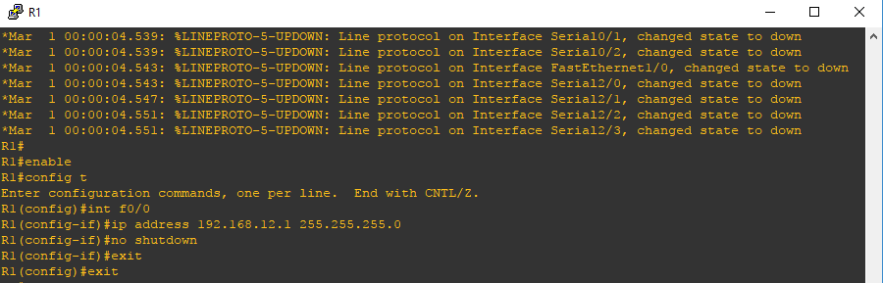
Configuration Example

Slide 13
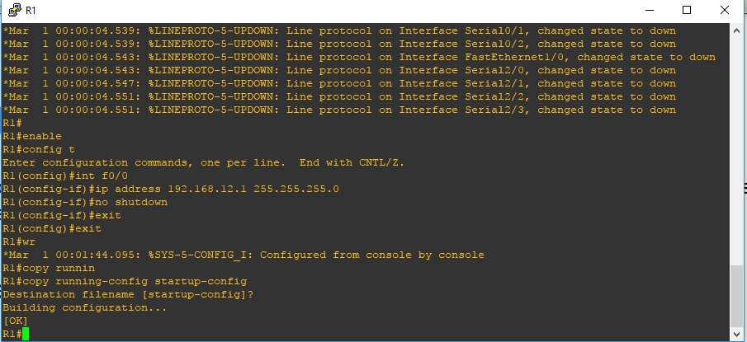
Save Router Configuration
Exit from configuration mode
R1#write memory (or wr)
This command write your configuration in memory
R1# copy running-­config startup-­config
This command will take your current configuration and save it to the startup configuration file

Slide 14
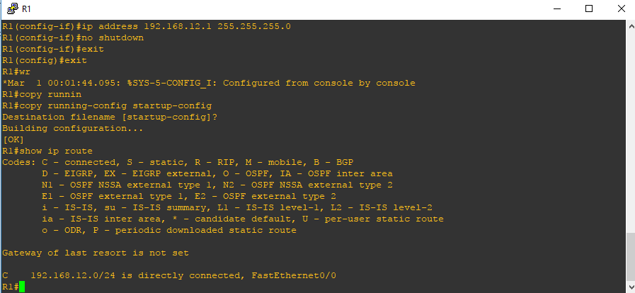
Verifying Your Configuration
Router# show ip route
Router# show ip interface brief

Slide 15
Lab3- ARP Protocol

Slide 16
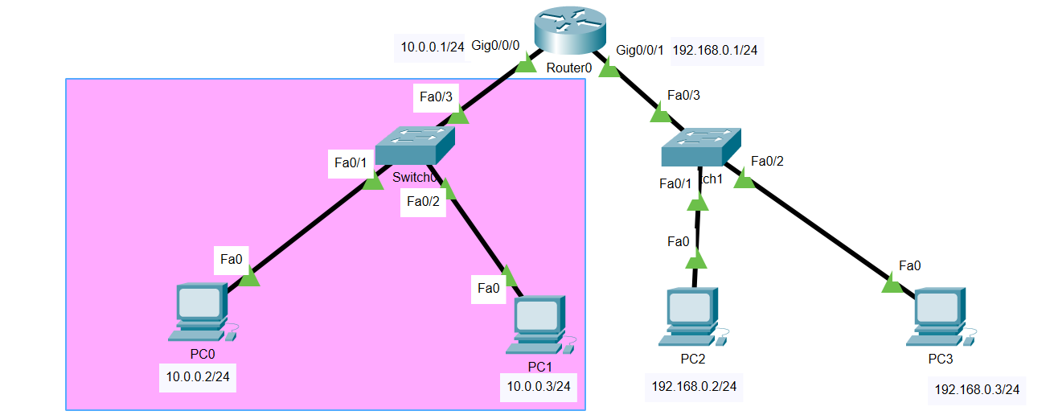
Lab Setup

Slide 17
Addressing table
create the preceding topology and configure the devices as per the values mentioned in the following table. First of all, configure the IP addresses on each device
On switches ; only configure their hostname.
Device | interfaces | IP Address
R1 | G0/0/0 G0/0/1 | 10.0.0.1/24 192.168.0.1/24
PC0 | Fa0 | 10.0.0.2/24
PC1 | Fa0 | 10.0.0.3/24
PC2 | Fa0 | 192.168.0.2/24
PC3 | Fa0 | 192.168.0.3/24

Slide 18
Part 1:Examine an ARP Request
Generate ARP requests by pinging 10.0.0.3 from 10.0.0.2.
Click 10.0.0.2 and open the Command Prompt.
Enter the arp -d command to clear the ARP table.
Enter Simulation mode and enter the command ping 10.0.0.3.
Click Capture/Forward once. The ARP PDU moves Switch1 while the ICMP PDU disappears, waiting for the ARP reply.
Q1. Open the PDU and record the destination MAC address. Is this address listed in the table above?
Click Capture/Forward to move the PDU to the next device.
Q2. How many copies of the PDU did Switch1 make?
Click Capture/Forward until the PDU returns to 10.0.0.2.
Q3. How many copies of the PDU did the switch make during the ARP reply?

Slide 19
Part 1:Examine an ARP Request
Examine the ARP table.
Note that the ICMP packet reappears. Open the PDU and examine the MAC addresses.
Q4. Do the MAC addresses of the source and destination align with their IP addresses?
Switch back to Realtime and the ping completes.
Click 10.0.0.2 and enter the arp –a command.
Q5. To what IP address does the MAC address entry correspond?
In general,
Q6. when does an end device issue an ARP request?

Slide 20
Part 2:Examine a Switch MAC Address Table
Generate additional traffic to populate the switch MAC address table.
From 192.168.0.2, enter the ping 192.168.0.3 command.
Click 10.0.0.2 and open the Command Prompt. ,Enter the ping 10.0.0.3 command.
Examine the MAC address table on the switches.
Click Switch1and then the CLI tab. Enter the show mac-address-table command.
Q7. Do the entries correspond to those in the table above?
Click Switch0, then the CLI tab. Enter the show mac-address-table command.
Q8. Do the entries correspond to those in the table above?

Slide 21
Part3:Examine the ARP Process in Remote Communications
Generate traffic to produce ARP traffic.
Click 192.168.0.2 and open the Command Prompt., Enter the ping 10.0.0.3 command.
Type arp –a.
Q9: What is the IP address of the new ARP table entry?
Enter arp -d to clear the ARP table and switch to Simulation mode.
Click Capture/Forward. Click the PDU that is now at Switch1.
Examine the ARP table on Router1.
Switch to Realtime mode. Click Router1 and then the CLI tab.
Enter the show arp command.
Q10: What happens to the first ping in a situation where the router responds to the ARP request?

Slide 22
Task
Post your pdf-format explanation report on the Google classroom due two days after lab.
All answers should be contained in one explanation report. DO NOT create a separate answer report for each question
Don't forget to provide your project as appendices for full credit.
22

Slide 24
Thank you…..!

